Slide 1

Notes:
© Copyright PresentationGO.com – The free PowerPoint and Google Slides template library

Slide 2

Baum Welch Algorithm Hidden Markov Models
Course: Stochastic Processes
DR\ Amr Ameen
Notes:
© Copyright PresentationGO.com – The free PowerPoint and Google Slides template library

Slide 3

Table of
Contents
01.
02.
03.
04.
Overview on MMs & HMMs
Introduction to Baum-Welch Algorithm
Baum-Welch Algorithm Phases
Baum-Welch Algorithm Challenges
We aim to provide a concise introduction to Markov models and Hidden Markov Models as the starting point for our discussion.
A comprehensive overview of the iterative procedure in Hidden Markov Models for parameter estimation from observed data.
We aim to explore the distinct phases involved in Baum-Welch Algorithm and highlighting its iterative steps.
Discuss the challenges associated with the Baum-Welch Algorithm, addressing complexities & potential limitations.
Notes:
Photo by Sean Pollock on Unsplash

Slide 4
Table of
Contents
05.
06.
07.
08.
Baum-Welch Algorithm Gains
Baum-Welch Applications
Implementation Using Python
Implementation Using R
An analysis of the advantages associated with the Baum-Welch Algorithm.
We discuss the real-world applications of the Baum-Welch Algorithm, shedding the light on one of its common applications which is Speech Recognition.
A practical implementation of the Baum-Welch Algorithm through Python programming for hands-on understanding and execution.
An implementation of the Baum-Welch Algorithm through R programming for practical insights and execution.
Notes:
Photo by Sean Pollock on Unsplash

Slide 5
Table of
Contents
09.
10.
11.
Additional Task:
Implementation Using Python for Markov Model.
Conclusion
References
A comprehensive summary of the study's findings, drawn from diverse sources such as research papers, YouTube, and Google, providing a holistic understanding of the topic.
We have acquired knowledge on the subject by consulting various sources, including research papers, YouTube, and Google.
Notes:
Photo by Sean Pollock on Unsplash

Slide 6


01
Overview on MMs and HMMs
Notes:
Photo by Floriane Vitaon Unsplash

Slide 7

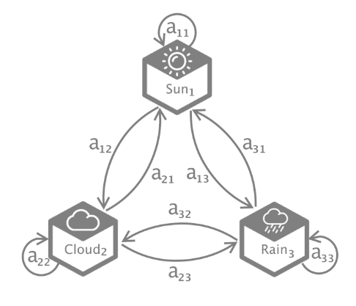

Markov Chains :
a stochastic model that describes a sequence of possible events in which the probability of each event depends only on the state attained in the previous event. In other words, the future state of the system depends only on its current state and not on the sequence of events that preceded it.
Notes:
Photo by Dmitry Demidkoon Unsplash

Slide 8
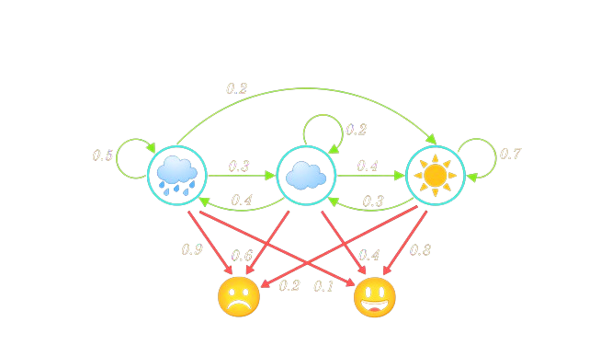
Hidden Markov Chains :
HMMs are statistical models that capture the relationship between a sequence of observations and a sequence of hidden states. They are widely used in temporal pattern recognition and have applications in various fields such as speech recognition, bioinformatics, and more.
Notes:
Photo by Dmitry Demidkoon Unsplash

Slide 9
02
Introduction to Baum-
Welch Algorithm
Notes:
Photo by Floriane Vitaon Unsplash

Slide 10
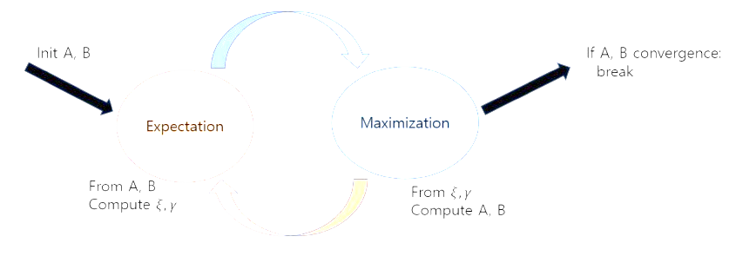
Baum-Welch Algorithm:
also known as the Training Sequence Problem , and it is a special case of the expectation-maximization (EM) algorithm.
Its primary purpose is to tune the parameters of a Hidden Markov Model (HMM), such as the state transition matrix P, the emission matrix E, and the initial state distribution π₀, in order to maximize the likelihood of the observed data given the model.
Notes:
Photo by Dmitry Demidkoon Unsplash

Slide 11
Baum-Welch Algorithm:
The Baum-Welch algorithm aims to find the optimal values for the transition probabilities and emission probabilities of an HMM given a set of observed sequences . It does this by iteratively updating the parameters based on the observed sequences and the current estimates of the parameters.
Notes:
Photo by Dmitry Demidkoon Unsplash

Slide 12
03
Baum-Welch Algorithm Phases
Notes:
Photo by Floriane Vitaon Unsplash

Slide 13
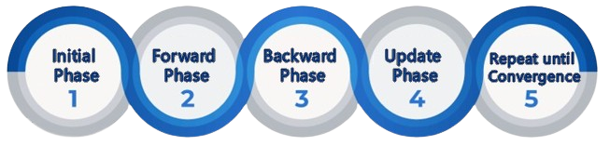
Baum-Welch Phase:
The algorithm utilizes the expectation-maximization (EM) framework, which consists of an expectation step and a maximization step.
The forward and the backward phase form the E-step of the EM algorithm, while the update phase itself is the M-step.
Notes:
Photo by Dmitry Demidkoon Unsplash

Slide 14
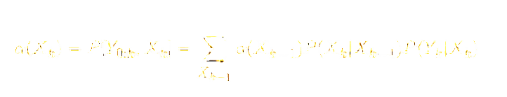
Baum-Welch Phase:
Initial Phase:
In the initial phase, the content of the parameter matrices P, E, π₀ are initialized, and it could be done randomly if there is no prior knowledge about them.
Forward Phase:
The algorithm computes the expected values of the hidden states given the observed data using the forward algorithm.
Notes:
Photo by Dmitry Demidkoon Unsplash

Slide 15
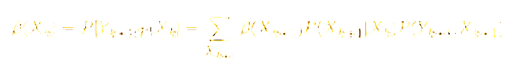
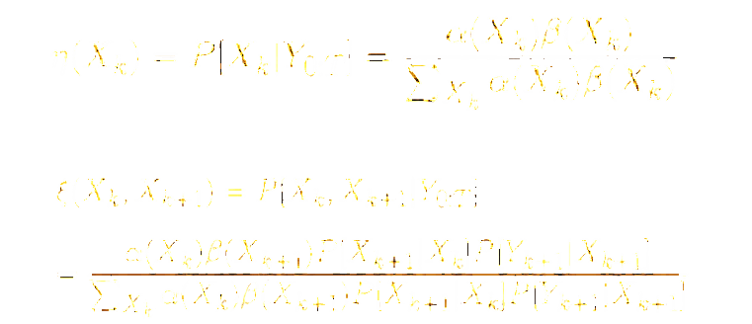
Baum-Welch Phase:
Backward Phase:
The algorithm computes the expected values of the hidden states given the observed data using the backward algorithm.
Update Phase:
The algorithm updates the parameters of the HMM based on the expected values computed in the expectation step.
Notes:
Photo by Dmitry Demidkoon Unsplash

Slide 16

Baum-Welch Phase:
Repeat until Convergence:
The Baum-Welch algorithm repeats the expectation and maximization steps iteratively until convergence, where the parameters of the HMM no longer change significantly or the maximum number of iterations is reached.
This makes it a powerful tool for training HMMs without requiring labeled training data.
Notes:
Photo by Dmitry Demidkoon Unsplash

Slide 17

Baum-Welch Phase:
» Mathematical or Statistical Institution:
Click Here
Notes:
Photo by Dmitry Demidkoon Unsplash

Slide 18
05
Baum-Welch Algorithm Gains
Notes:
Photo by Floriane Vitaon Unsplash

Slide 19

Pros & Cons :
Advantages:
Parameter Estimation.
Expectation-Maximization.
Versatility.
Efficiency.
Adaptability to Constrained Data
Unsupervised Learnings
Notes:
Photo by Dmitry Demidkoon Unsplash

Slide 20
04
Baum-Welch Algorithm Challenges
Notes:
Photo by Floriane Vitaon Unsplash

Slide 21

Baum-Welch Challenges:
Disadvantages:
Convergence to Local Optima.
Sensitivity to Initial Parameter Estimates.
Computational Complexity.
Assumption of Stationarity.
Lack of Guarantees
Notes:
Photo by Dmitry Demidkoon Unsplash

Slide 22
06
Baum-Welch Applications
Notes:
Photo by Floriane Vitaon Unsplash

Slide 23
Baum-Welch Applications:
Speech Processing
Bioinformatics
NLP
Finance
Signal Processing
Notes:
Photo by Dmitry Demidkoon Unsplash

Slide 24

Baum-Welch Applications:
Speech Recognition:
Sequence of observed speech vectors corresponding to a word sequence is generated by a parametric model.
The parametric model designed to capture the underlying patterns and structures in the speech signal.
Common types : HMMs and DNNs.
The choice between DNNs and HMMs depends on factors such as the available data, computational resources, and the specific requirements of the application.
Notes:
Photo by Dmitry Demidkoon Unsplash

Slide 25

Baum-Welch Applications:
Speech Recognition:
speech recognizer maps the input speech vectors with the word sequence that needs to be recognized.
mapping may not be one-to-one since different word sequences can have similar speech vectors.
Markov model is used :Acoustic Training.
a Viterbi algorithm was used to carry out acoustic training but Baum-Welch training algorithm is found to be more effective and precise.
Notes:
Photo by Dmitry Demidkoon Unsplash

Slide 26
07
Implementation using Python
Notes:
Photo by Floriane Vitaon Unsplash

Slide 27

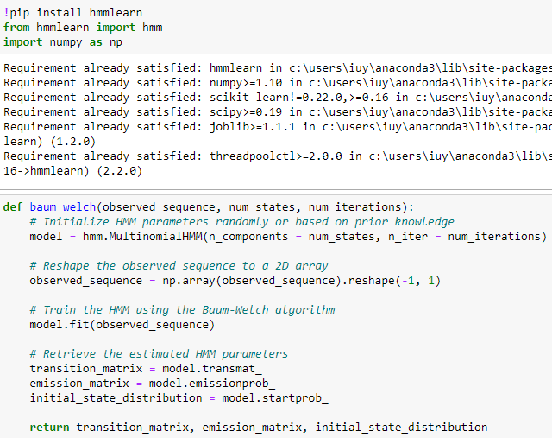
PYTHON SOURCE CODE:
Source Code
Notes:
Photo by Dmitry Demidkoon Unsplash

Slide 28
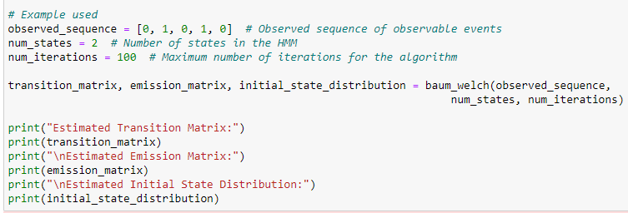
PYTHON SOURCE CODE:
Source Code
Notes:
Photo by Dmitry Demidkoon Unsplash

Slide 29
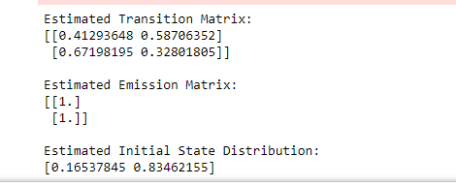
PYTHON SOURCE CODE:
Output:
Source Code
Notes:
Photo by Dmitry Demidkoon Unsplash

Slide 30
08
Implementation using R
Notes:
Photo by Floriane Vitaon Unsplash

Slide 31

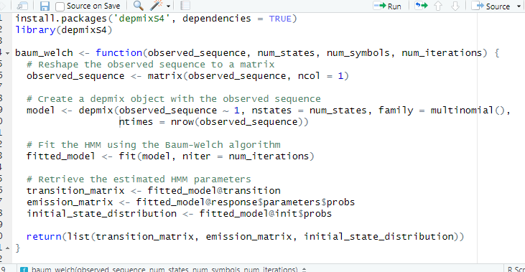
R SOURCE CODE:
Source Code
Notes:
Photo by Dmitry Demidkoon Unsplash

Slide 32
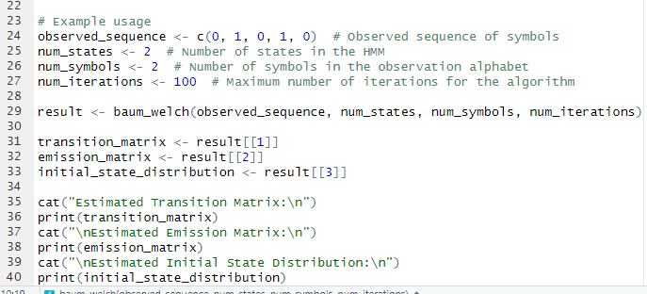
R SOURCE CODE:
Source Code
Notes:
Photo by Dmitry Demidkoon Unsplash

Slide 33
09
Implementation Using Python for Markov Model
Notes:
Photo by Floriane Vitaon Unsplash

Slide 34
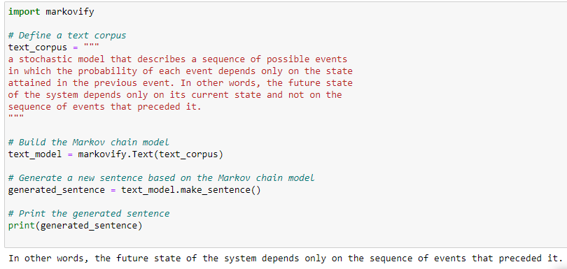
Markov Chain Python Code :
Source Code
Notes:
Photo by Dmitry Demidkoon Unsplash

Slide 35
10
Conclusion
Notes:
Photo by Floriane Vitaon Unsplash

Slide 36

Conclusion:
The Baum–Welch algorithm uses the well known EM algorithm to find the maximum likelihood estimate of the parameters of a hidden Markov model given a set of observed feature vectors.
The Baum-Welch algorithm plays a vital role in estimating the parameters of hidden Markov models, enabling us to gain insights and make predictions in diverse fields.
It offers efficient parameter estimation, making it a valuable tool for modeling and analyzing complex systems.
Notes:
Photo by Dmitry Demidkoon Unsplash

Slide 37
Conclusion:
It uses the forward-backward algorithm to compute the expected counts of state transitions and observations, and iteratively updates the parameters until convergence is achieved.
Notes:
Photo by Dmitry Demidkoon Unsplash

Slide 38
11
References
Notes:
Photo by Floriane Vitaon Unsplash

Slide 39

References:
https://isip.piconepress.com/courses/msstate/ece_8463/projects/2000_spring/final_paper/baum_welch_v0.pdf
https://youtu.be/nTwb9MXIBtM?si=y6SW7_j2nwYfJfuN
https://www.researchgate.net/profile/Aravind-Ganapathiraju/publication/255632752_Baum-Welch_Re-estimation_of_Hidden_Markov_Model/links/5610c41908ae6b29b49c8f9e/Baum-Welch-Re-estimation-of-Hidden-Markov-Model.pdf
https://en.wikipedia.org/wiki/Baum%E2%80%93Welch_algorithm
https://pure.royalholloway.ac.uk/ws/portalfiles/portal/1446635/Hidden_Markov_Models_Theory_and_Applications.pdf
Notes:
Photo by Dmitry Demidkoon Unsplash

Slide 40

Presented By:
Thank You
Thank You
Dina Mahmoud Mohamed
Esraa Sayed Ahmad
Heba Allah Mohamed Ibrahim
Nada Elaraby Mohamed
Toka Mohamed Abdou

Slide 41

Notes:
Photo by Dmitry Demidkoon Unsplash

